Slide 1
Contiguous Storage
Module F: Arrays, Simple Data Structure
Contiguous Storage
Searching
Sorting
Notes:
Prepared by Thân Văn Sử

Slide 2
Objectives
How to manage a group of data?
Store
Input
Output
Search
Sort
…

Slide 3
Content
Introduction to contiguous storage
Arrays
One-dimensional Arrays
Declaration
Memory Allocation
Initialization
Accessing elements
Traversing
1-D Arrays are parameters of functions
Searching
Sorting
2-D Arrays

Slide 4
1- Contiguous Storage
Commonly, a group of the same meaning elements are considered.
They are stored in a contiguous block of memory.
Ex: Group of 10 int numbers ➔ 40 bytes block is needed.
Data are considered can be a group of some items which belong to some different data types → Contiguous memory block is partitioned into some parts which have different size, one part for an item.
Data structure: A structure of data stored.
Array is the simplest data structure which contains some items which belong to the sane data type.
Common used operations on a group: Add, Search, Remove, Update, Sort

Slide 5
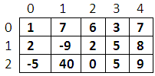
2- Arrays
Array: A group of elements which belong to the same data type. Each element is identified by it’s position (index).
index
0
1
2
3
4
5
6
7
8
9
a
(array)
5
4
8
15
90
27
34
21
152
80
a[3]
element
a[i] is an integer
column
m
m[1][3]
row
Dimension: Direction that is used to perform an action on array.
Number of dimensions: Number of indexes are used to specify an element.
Common arrays: 1-D and 2-D arrays.
Name of an array: An array has it’s name.
Notes:
Index: chỉ số
a: phần tử mang giá trị […]
Mọi thao tác trên mảng cần đc thông qua chỉ số. Vì chỉ số không bao giờ bị trùng lập

Slide 6
3- One Dimensional (1-D)Arrays
1-D array: a collection of items (elements, terms) which belong to the same data type and are stored contiguously in memory.
Each element is identified by a unique index of it’s position in the array (an integer from 0).
index
0
1
2
3
4
5
6
7
8
9
5
4
8
15
90
27
34
21
152
80
a
(array)
a[3]
element
a[i] is an integer
Notes:
Mảng số nguyên thì toàn bộ mang giá trị nguyên không đan xen kiểu dữ liệu khác
Mảng bắt đầu với chỉ số 0

Slide 7
1-D Arrays: Declaration
If the array is stored in the stack segment → Use a STATIC array → The compiler will determine the array’s storage at compile-time.
If the array is stored in the heap → Use a pointer (DYNAMIC array) → The array’s storage will be allocated in the heap at run-time through memory allocating functions (malloc, calloc, realloc)
DataType ArrayName[NumberOfElements] ;
Examples:
int a1[5];
char s[12];
double a3[100];
How compilers can determine the memory size of an array?
NumberOfElements * sizeof(dataType)
➔ int a1[5] → 5 *sizeof(int) = 5*4 = 20 bytes
float *a;
a = (float*)calloc (10, sizeof(float)); /* allocate a block of 10 float numbers */
Notes:
Mảng tĩnh : đc cấp phát ở vùng nhớ trong stack
Mảng động: đc cấp phát vùng nhớ Heap (vùng nhớ khi bắt đầu chạy)

Slide 8
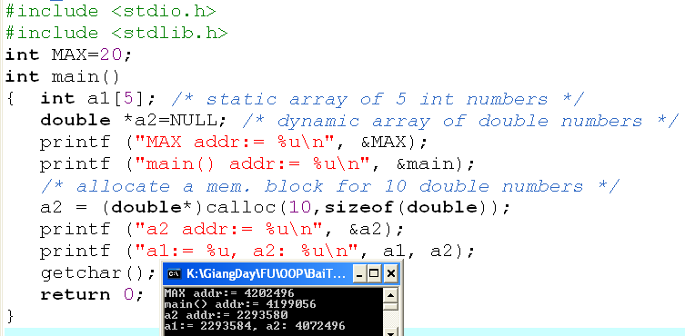
1-D Arrays: Memory Allocation
Data segment
4202496
20
The name of the array is the address of the first element.
code
Code segment
4199056
80
bytes
Heap
4072496
Stack segment
20
bytes
a1: 2293584
a2:2293580
4072496
Notes:
5 thuật toán của MẢNG
Thêm, xóa, sửa, tìm kiếm, sắp xếp

Slide 9
1-D Arrays: Initialization & Accessing Elements
Initialize an array:
Type a[] = {val1, val2, … };
How to access the i^{th} element of the array a?
a is the address of the first element. Based on operation on pointers:
a+i : address of the i^{th} element, another way: &a[i]
*(a+i): value of the i^{th} element, another way: a[i]

Slide 10
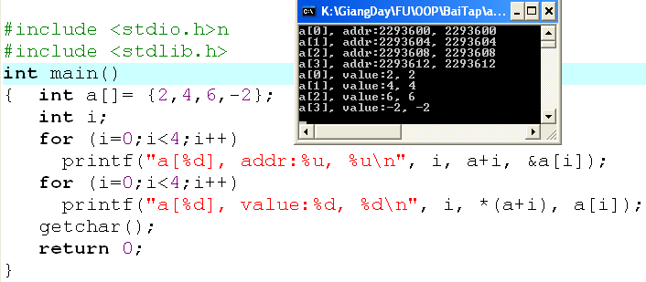
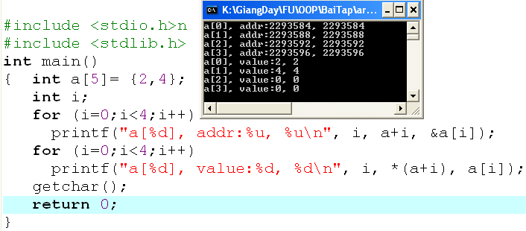
1-D Arrays: Init. & Accessing…
Compiler will automatically count number of initial values to determine the size of array memory
The size of array memory is pre-defined.
Compiler will fill 0 to elements which are not initialized.
int a[5];
Elements contain un-predictable values because they are local variables.
TEST IT !!!!

Slide 11
1-D Arrays: Traversing
A way to visit each element of an array
Suppose that the 1-D array, named a, containing n elements.
Forward traversal:
int i;
for (i=0; i<n; i++)
{ [if (condition)] Access a[i];
}
Backward traversal:
int i;
for (i=n-1; i >=0; i--)
{ [if (condition)] Access a[i];
}

Slide 12
1-D Array is a Function Parameter
The array parameter of a function is the pointer of the first element of the array.
Input an array of n integers
void input (int* a, int n)
Input elements of an array of integers which it’s number of element is stored at the pointer pn
void input (int a[], int*pn)
Output an array of n double numbers
void output (double a[], int n)
Calculate the sum of an array of n integers
int sum (int *a, int n)

Slide 13
Array Function Parameter: Demo.
Develop a C-program that will:
Accept values to an integer array that may contain 100 elements.
Print out the it’s maximum value.
Print out it’s elements.
Print out it’s even values.
Nouns:
Constant: MAXN=100
Static array of integers
→ int a[MAXN]
Real number of elements → int n
Maximum value
→ int maxVal.
Verbs:
Begin
Input n (one value)
Input a, n (function)
maxVal = get maximum value in a, n (function)
Print out maxVal (one value)
Print out a, n (function)
Print even values in a, n (function)
End

Slide 14
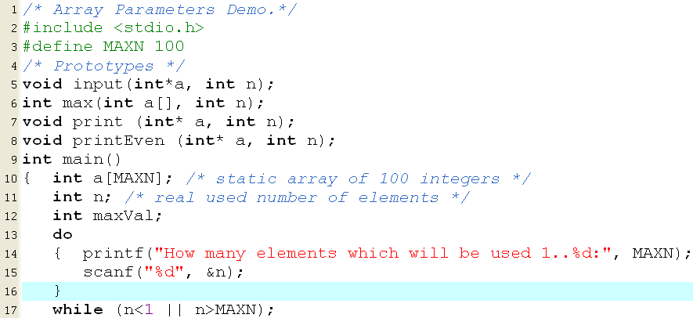
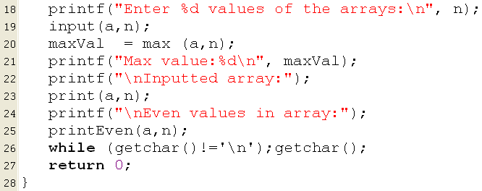
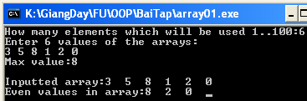
Array Function Parameter: Demo 1.

Slide 15
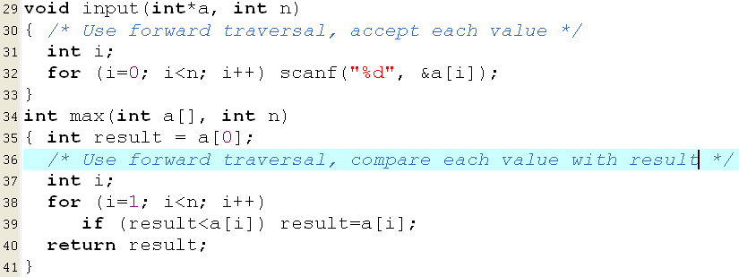
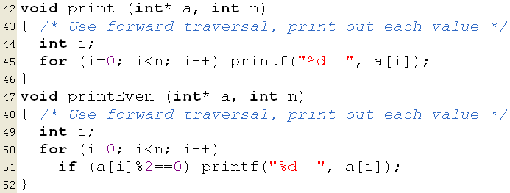
Array Function Parameter: Demo 1.

Slide 16
Array Function Parameter: Demo 1.
Comments
If you allocate an array having 100 elements but 6 elements are used then memory is wasted.
If If you allocate an array having 100 elements but 101 elements are used then there is a lack of memory.
Solution: Use a dynamic array.

Slide 17
Array Function Parameter: Demo 1.
replace
int* a
insert
a = (int*) calloc (n, sizeof(int));
Other functions are preserved.

Slide 18
Array Function Parameter: Demo 1.

Slide 19
Array Function Parameter: Demo 2.
Develop a C-program that will:
Accept values to an integer array that may contains 100 elements. The input will terminate when user enters the value of zero.
Print out the it’s maximum value.
Print out it’s elements.
Print out it’s even values.
The difference between this problem with the previous one is the input operation can terminate abruptly when 0 is accepted.
Memory block of the array needs to be allocated in excess
The function for input values of the array must be modified for this case and the number of elements is updated after each valid value is accepted.

Slide 20
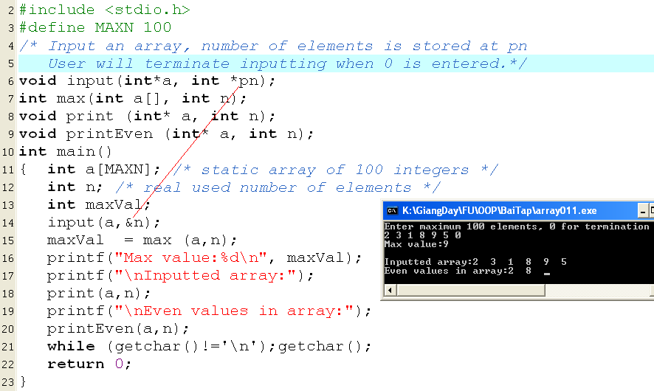
Array Function Parameter: Demo 2.

Slide 21
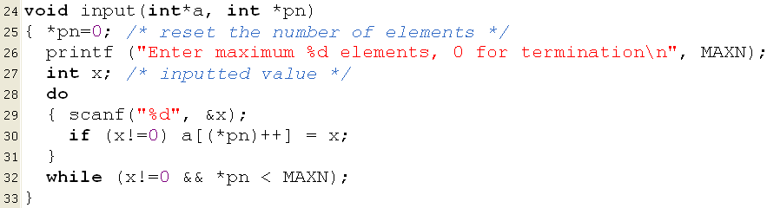
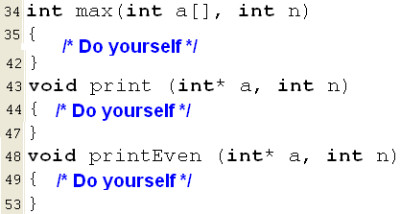
Array Function Parameter: Demo 2.
x=3
n=0 → 1
0
3
x=7
n=3→ 4
0 | 1 | 2
3 | 5 | 2

Slide 22
1-D Arrays: Searching
A search algorithm finds the record of interest using the key array
Return value: The positional index at which the interest value is found.
Two common search algorithms are
linear search
binary search

Slide 23
1-D Arrays: Searching…
Linear search: Find the position of the value x in the array a having n elements.
Search the value of 6 in the array a having 8 items.
5 | 9 | 2 | 7 | 6 | 5 | 2 | 5
i=0 | 1 | 2 | 3 | 4
There may be n comparisons performed.
Search the value of 12 in the array a having 8 items.
5 | 9 | 2 | 7 | 6 | 5 | 2 | 5
i=0 | 1 | 2 | 3 | 4 | 5 | 6 | 7
-1
int firstLinearSearch ( int x, int a[], int n)
{ int i;
for ( i=0; i<n; i++)
if ( x == a[i] ) return i;
return -1;
}
int lastLinearSearch ( double x, double *a, int n)
{ int i;
for ( i=n-1; i>=0; i--)
if ( x == a[i] ) return i;
return -1;
}

Slide 24
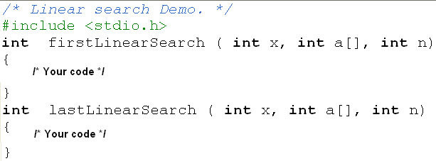
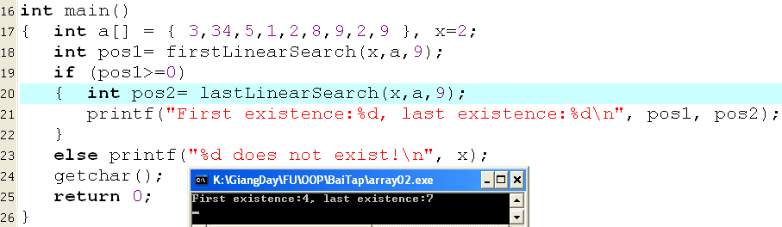
1-D Arrays: Linear Searching…

Slide 25
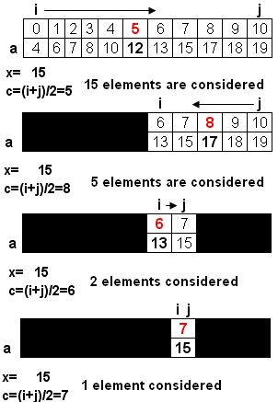
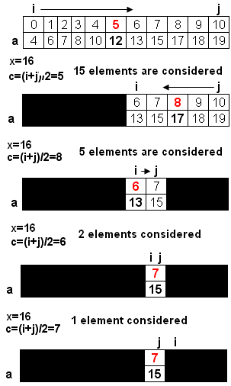
1-D Arrays: Binary Searching…
Binary search
- Condition for application: Values in the array were sorted.
int binarySearch ( int x, int a[], int n)
{ int i=0, j= n-1, c ;
while (i<=j)
{ c= (i+j)/2;
if ( x== a[c] ) return c ;
if (x < a[c] ) j = c-1;
else i = c +1;
}
return -1;
}
return c (7)
i>j → return -1

Slide 26
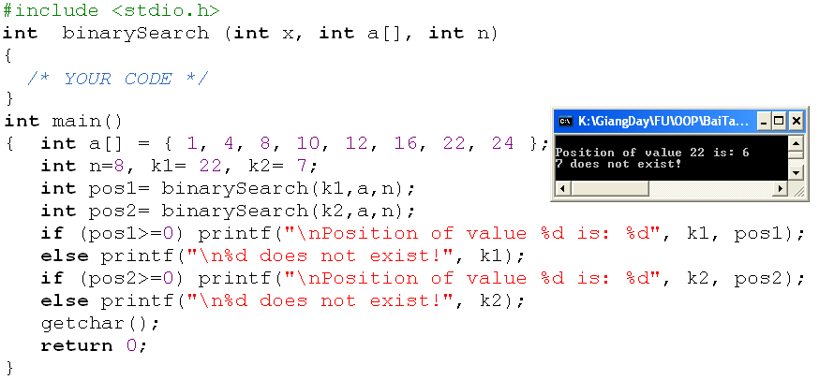
1-D Arrays: Binary Searching…
No. of elements considered | No. of comparisons
n= 2^{m} | 1
2^{m-1} | 1
2^{m-2} | 1
… | …
2⁰ | 1
Sum | m+1 = log₂(n) +1
Evaluation:

Slide 27
1-D Arrays: Sorting
Sorting: Changing positions of elements in an array so that values are in a order based on a pre-defined order relation.
Default order relation in set of numbers: Value order
Default order relation in a set of characters/ strings: Dictionary order
Only two sorting algorithms are introduced here.
Selection Sort
Bubble Sort

Slide 28
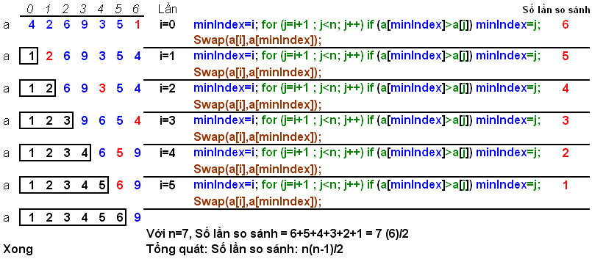
1-D Arrays: Selection Sort
Find the minimum value in the list
Swap it with the value in the first position
Repeat the steps above for remainder of the list
Notes:
i: vòng lặp
j: phần tử được sắp xếp

Slide 29
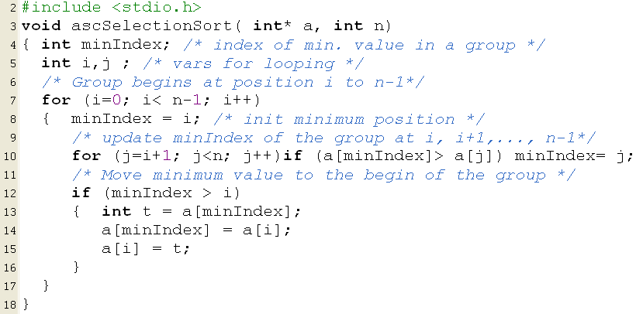
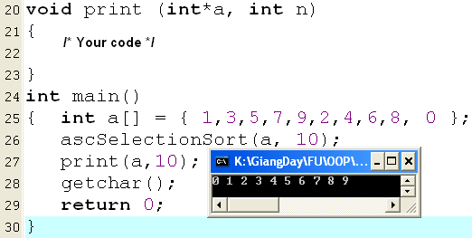
1-D Arrays: Selection Sort

Slide 30
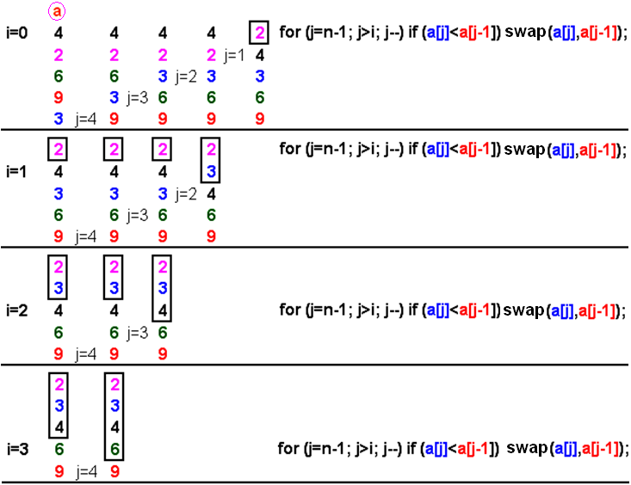
1-D Arrays: Bubble Sort
It works by repeatedly stepping through the list to be sorted, comparing two items at a time and swapping them if they are in the wrong order.
The pass through the list is repeated until no swaps are needed, which means the list is sorted

Slide 31
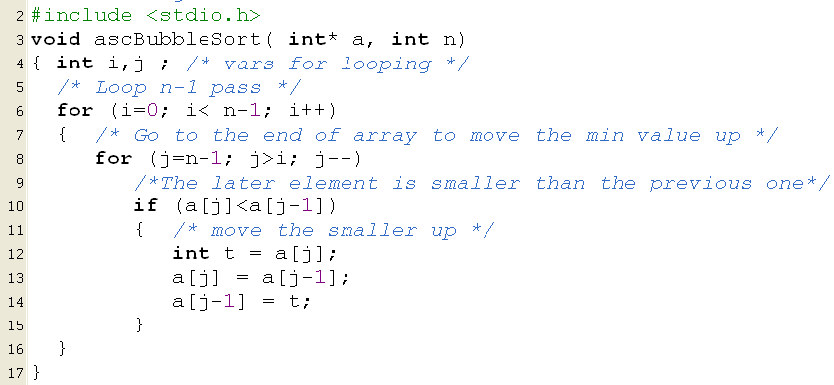
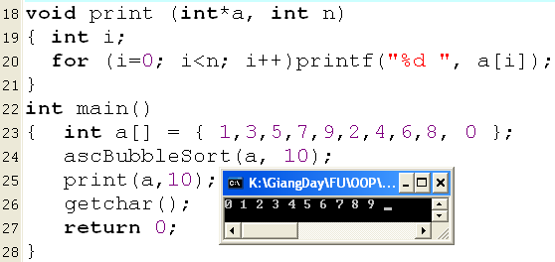
1-D Arrays: Bubble Sort…

Slide 32
1-D Arrays: A Sample
Develop a C-program that helps user managing an 1-D array of integers (maximum of 100 elements) using the following simple menu:
1- Add a value
2- Search a value
3- Remove the first existence of a value
4- Remove all existences of a value
5- Print out the array
6- Print out the array in ascending order (positions of elements are preserved)
7- Print out the array in descending order (positions of elements are preserved)
Others- Quit

Slide 33
1-D Arrays: A Sample…
In this program, user can freely add or remove one or more elements to/ from the array. So, an extra memory allocation is needed (100 items).
Data:
Array of integers → int a[100], n
searched/added/removed number → int value
Functions:
int menu() → Get user choice
int isFull(int *a, int n) - Testing whether an array is full or not
int isEmpty(int *a, int n) - Testing whether an array is empty or not
void add(int x, int*a, int*pn) → adding an element to the array will increase number of elements
int search(int x, int *a, int n) → return a position found in the array
int removeOne (int pos, int*a, int*pn) → Removing a value at the position pos will decrease number of elements → return 1: successfully, 0: fail
int remove All(int x, int*a, int*pn) → Removing a value will decrease number of elements → return 1: successfully, 0: fail
void printAsc(int*a, int n) – printing array, elements are preserved
void printDesc(int*a, int n) – printing array, elements are preserved
void print(int*a, int n)

Slide 34
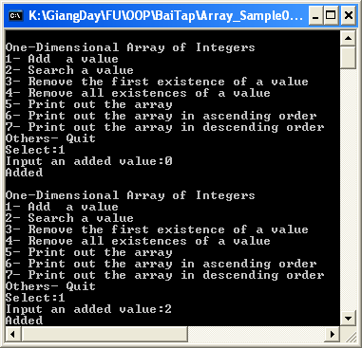
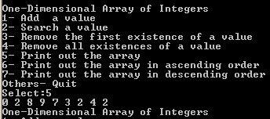
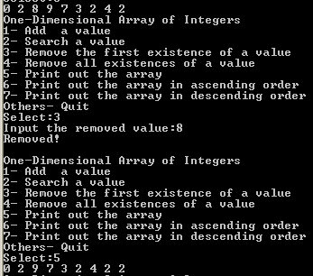
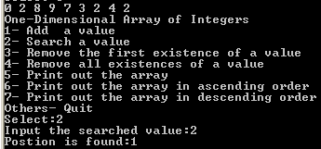
1-D Arrays: A Sample…
After values 0 , 2, 8, 9, 7, 3, 2, 4, 2 are added. Use menu 5 to view them.
Search option
Remove one option

Slide 35
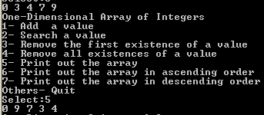
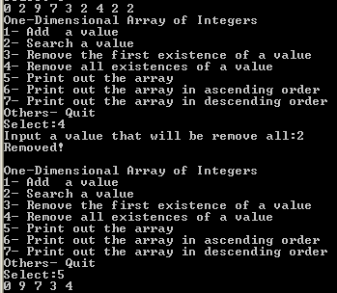
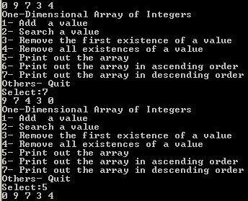
1-D Arrays: A Sample…
Print out in ascending order (elements are preserved)
Remove all option
Print out in descending order (elements are preserved)

Slide 36
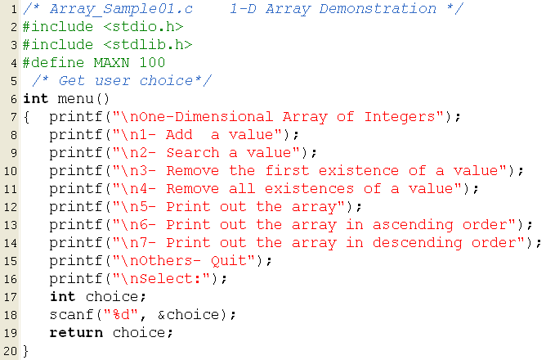
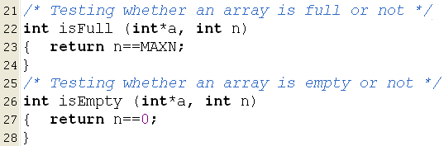
1-D Arrays: A Sample…

Slide 37
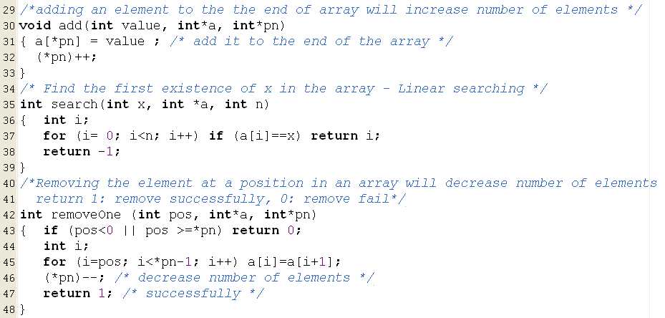
1-D Arrays: A Sample…
index
0 | 1 | 2 | 3 | 4 | 5 | 6 | 7 | 8
0 | 2 | 9 | 7 | 3 | 2 | 4 | 2 | 2
 | 9 | 7 | 3 | 2 | 4 | 2 | 2

Slide 38
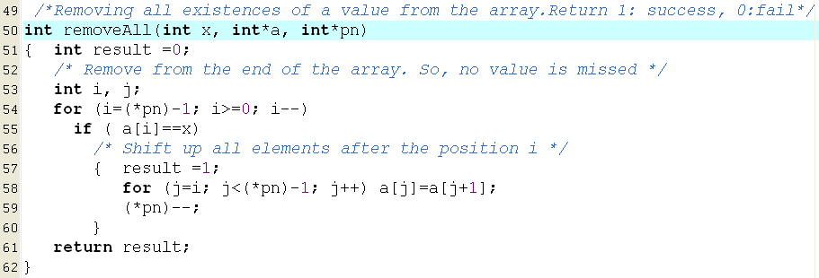
1-D Arrays: A Sample…
0 | 1 | 2 | 3 | 4 | 5 | 6 | 7 | 8
0 | 2 | 9 | 7 | 3 | 2 | 4 | 2 | 2
0 | 2 | 9 | 7 | 3 | 2 | 4 | 2
0 | 2 | 9 | 7 | 3 | 2 | 4
0 | 2 | 9 | 7 | 3 | 2 | 4
0 | 2 | 9 | 7 | 3 | 4
0 | 2 | 9 | 7 | 3 | 4
0 | 2 | 9 | 7 | 3 | 4
0 | 2 | 9 | 7 | 3 | 4
0 | 9 | 7 | 3 | 4
0 | 9 | 7 | 3 | 4

Slide 39
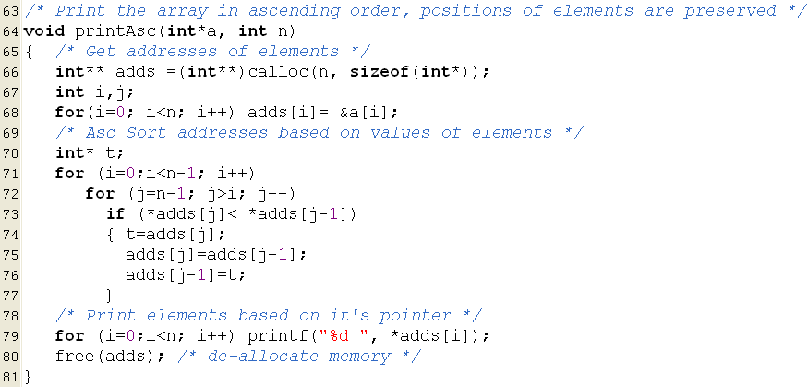
1-D Arrays: A Sample…
2293504
2293492
2293488
2293496
2293500
Values of pointers after sorting
2293504
2293500
2293496
2293492
4223516
2293488
adds
4223516
2293504
5
2293500
1
2293496
2
2293492
4
2293488
3

Slide 40
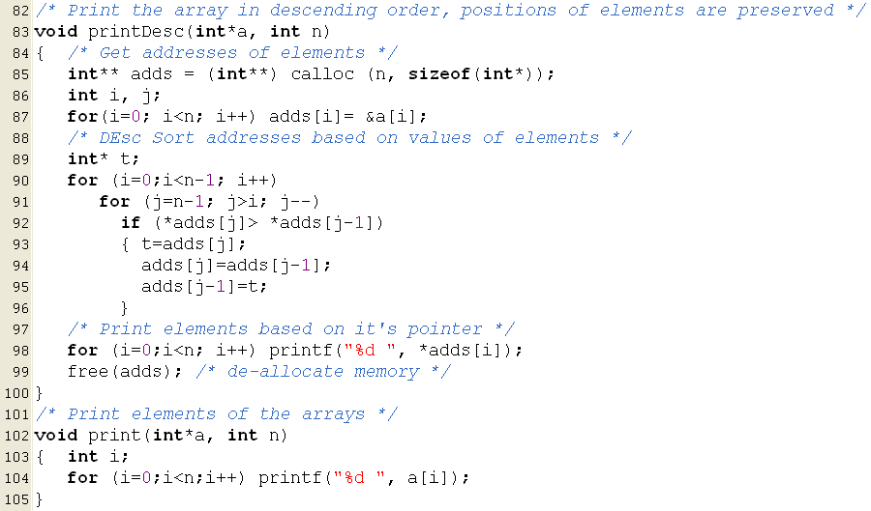
1-D Arrays: A Sample…

Slide 41
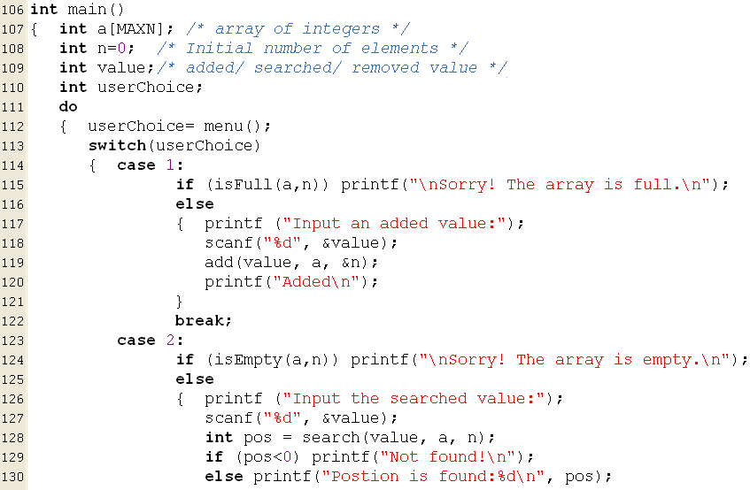
1-D Arrays: A Sample…

Slide 42
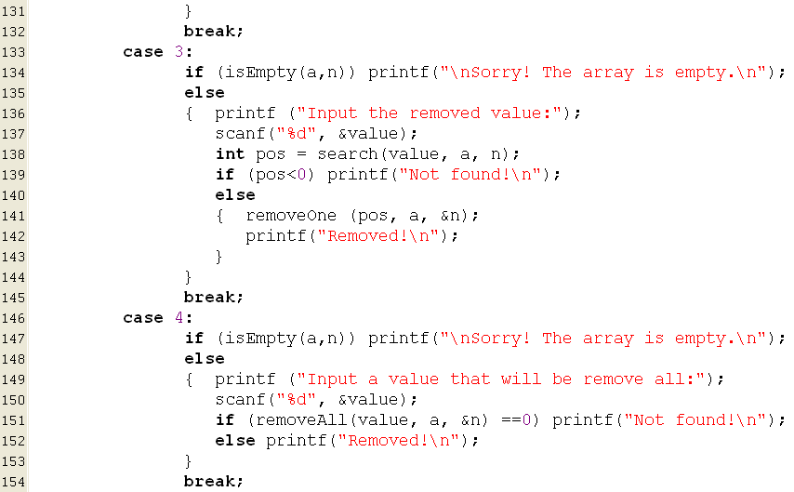
1-D Arrays: A Sample…

Slide 43
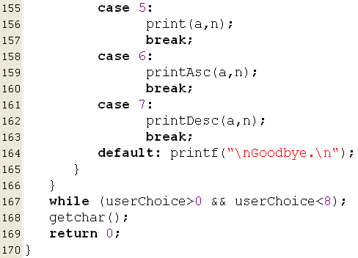
1-D Arrays: A Sample…

Slide 44
4- Two-Dimensional Arrays
A group of elements which belong the same data type and they are divided into some rows and some column (it is called as matrix also).
Each element is identified by two indexes (index of row, index of column).
column
The next slide will demonstrate how static and dynamic 2-D arrays are stored.
m
m[1][3]
row
Traversing a matrix:
for ( i =0; i<row; i++)
{ for ( j=0; j< column; j++)
[if (condition)] Access m[i][j];
}

Slide 45
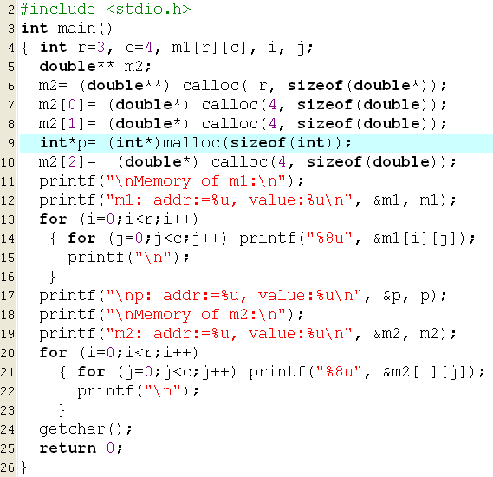
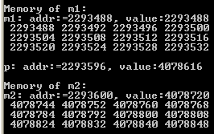
3- 2-D Arrays: Memory Structure
4078848
4078840
4078832
H
E
A
P
4078824
4078808
4078800
4078792
4078784
4078768
4078760
4078752
4078744
4078824
4078784
4078720
4078744
4078616
m2
2293600
4078720
p
2293596
4078616
S
T
A
C
K
2293532
2293528
2293524
2293520
2293516
2293512
2293508
2293504
2293500
2293496
2293492
m1
2293488

Slide 46
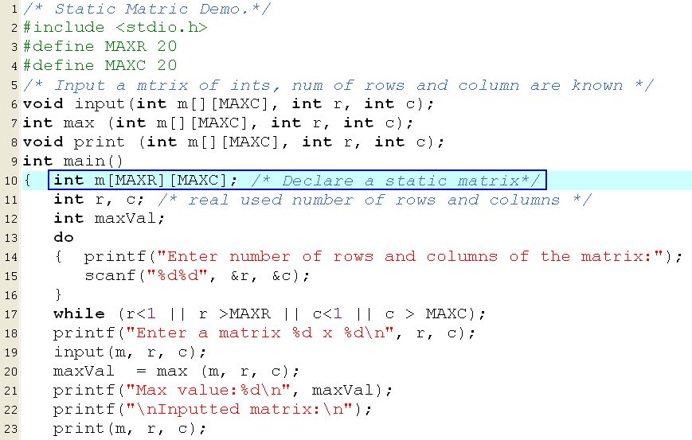

Static 2-D Arrays Demo.
Accept a matrix maximum 20x20.
Print out maximum value in it, print out the matrix.
Keep in your mind the way to specify a matrix as a parameter of a function ( the number of column must be pre-defined.).

Slide 47
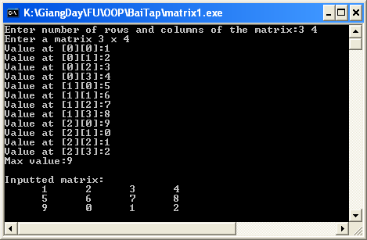
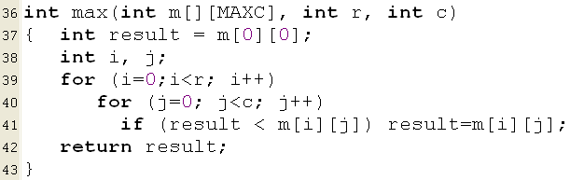
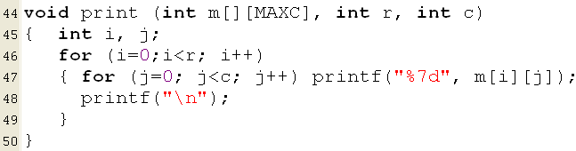
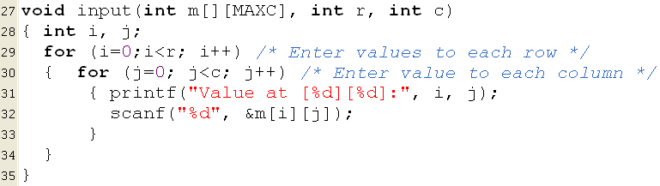
Static 2-D Arrays Demo.

Slide 48
Summary
Array is the simplest data structure for a group of elements which belong to the same data type.
Each element in an array is identified by one or more index beginning from 0.
Number of dimensions: Number of indexes are used to identify an element.
Static arrays → Stack segment
Type a[MAXN];
Type m[MAXROW][MAXCOL];
Dynamic array: Use pointer and allocate memory using functions
double *a = (double*)calloc(n, sizeof(double));
int** m = (int**) calloc(row, sizeof(int*));
for (i=0; i<row; i++) m[i]= (int*)calloc(col, sizeof(int));

Slide 49
Summary
Accessing elements in an array:
1-D Array (a) |  | 2-D Array (m)
Address | Value | Address | Value
&a[index] | a[index] | &m[i][j] | m[i][j]
a+index | *(a+index)
Compiler determines the address of an element:
a + index*sizeof(DataType) |  | m + (i*NumCol + j)*sizeof(DataType)
Common operations on arrays:
Add an element
Search an element
Remove an element
Input
Output
Sort
Base of algorithms on arrays: Traversing

Slide 50
Exercise- Do yourself
Develop a C-program that helps user managing an 1-D array of real numbers(maximum of 100 elements) using the following simple menu:
1- Add a value
2- Search a value
3- Print out the array
4- Print out values in a range (minVal<=value<=maxVal, minVal and maxVal are inputted)
5- Print out the array in ascending order (positions of elements are preserved)
Others- Quit

Slide 51
Thank You

